Slide 1
UE19CS390B – Capstone Project Phase – 2
Project Progress Review #1
Project Title : Automated Billing cart
Project ID : 75
Project Guide : Prajwala T.R
Project Team :
PES2U1G9CS198 Kuntal Gorai
PES2UG19CS346 S V S C Santosh
PES2UG19CS391 Skanda S
PES2UG19CS454 Vijay Murugan A S

Slide 2
Outline
Abstract and Scope of the Project
Capstone Project Phase – 1
Summary of work
Inferences drawn from Literature Survey
Expected Deliverables
Gantt chart

Slide 3
Abstract and Scope
Provide a basic introduction of the project and also an overview of scope it entails.
Set the context.

Slide 4
Summary of Work Done in Capstone Project Phase - 1
Provide summary of Phase – 1.
Include the suggestions and improvements made.

Slide 5
Expected Deliverables
List of tasks:
Collecting Good quality Dataset.
Decide on final structure in which data needs to be given to the model to work.
Decide on models which can be used in Ensemble Learning.
Train all the models on Collab using the same data and use the accuracy obtained as the weights.
Convert the models into a necessary format to be integrated with android studio Based app.
Determine the UI of the app as to what all pages are needed and how to design the same.
Decide on what and how database can be used to ensure all apps work with same data.
Make necessary changes in Java to use the Deep learning models developed and ensure consistency between the two.
Integrate app with Hardware IO components.
Make necessary Changes to ensure user-friendliness and ease of use.

Slide 6
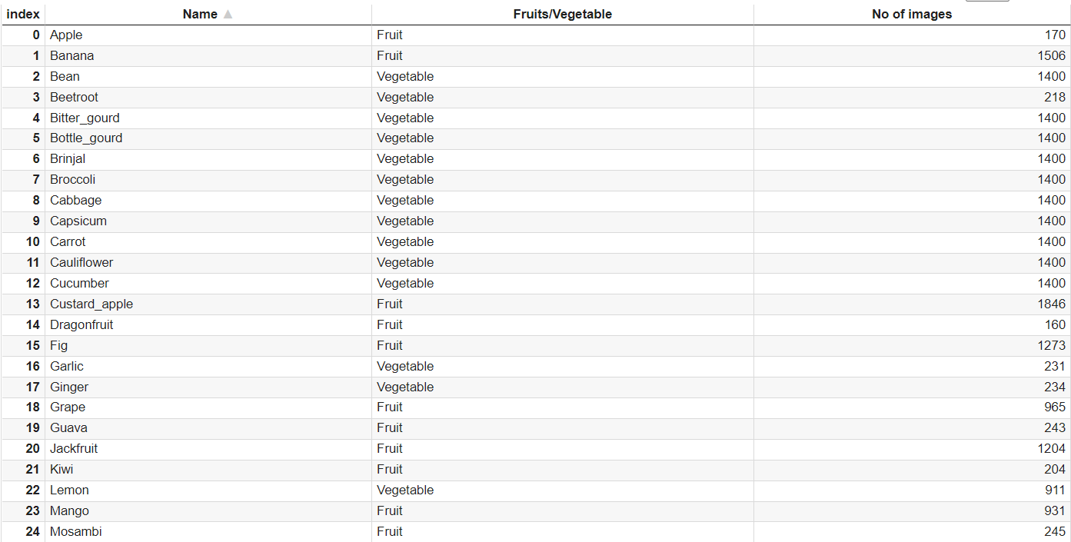
Expected Deliverables
Data Collection: Data Frame showing Necessary Information

Slide 7
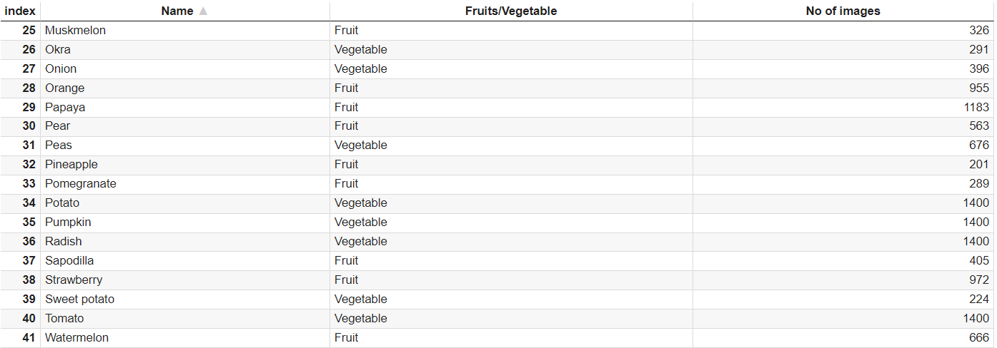
Expected Deliverables
Data Collection: Data Frame showing Necessary Information

Slide 8
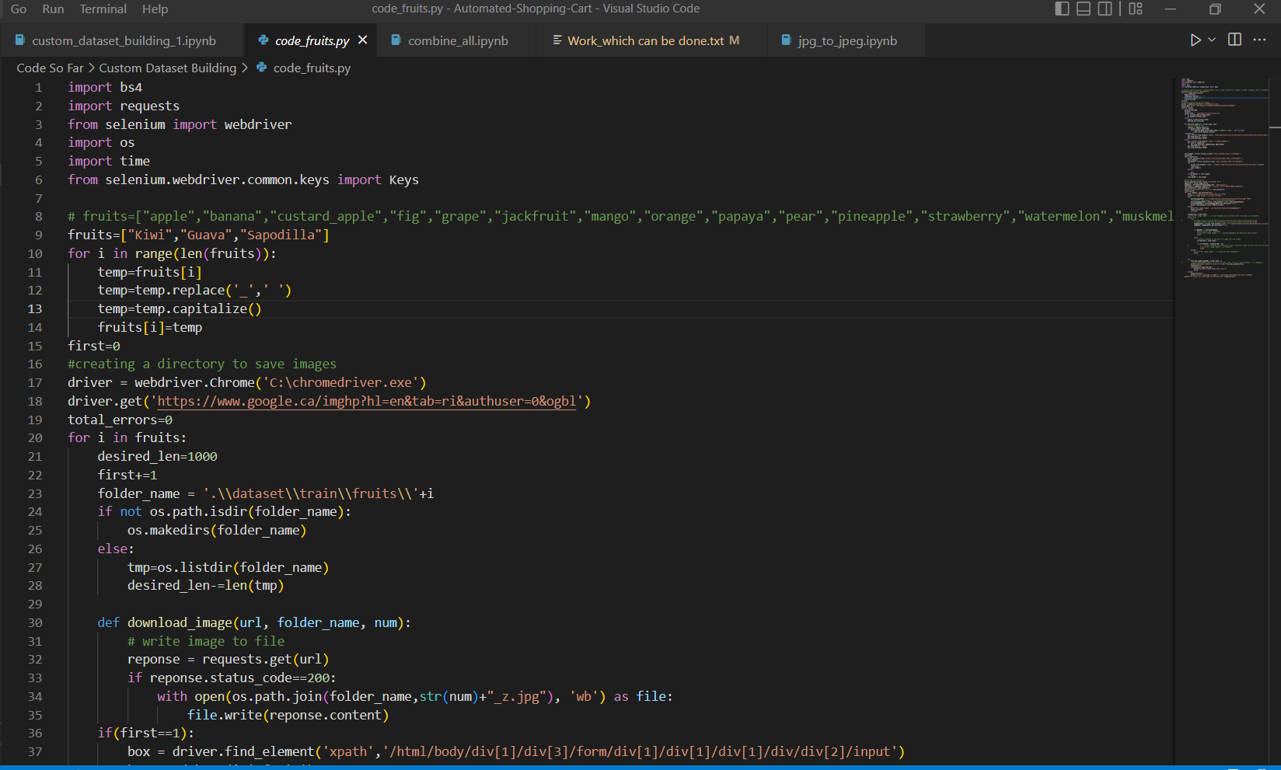
Expected Deliverables
Data Preparation: The Dataset Currently being used has been obtained by Manual downloading images from website <images.cv> and later we have extended the same for new classes which could not be found by writing a python code which scrapes the google images search of the class of fruit or vegetable needed and downloads high resolution images of the same automatically until the desired number of images are obtained or the search results exhaust.

Slide 9
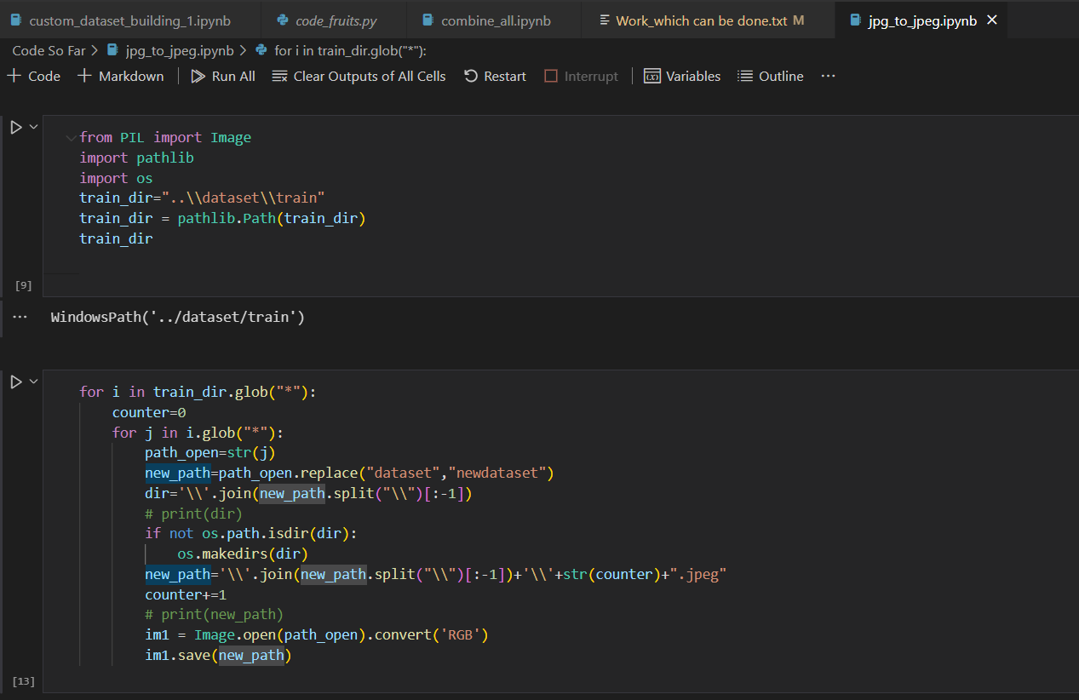
Expected Deliverables
Data Pre-processing: The images downloaded have different formats some of which might not be acceptable to be taken in as input to the model and the images downloaded do not have RGB pixels for all images so necessary conversions to .jpeg, .jpg, .png had to be done in addition to filter junk images coming out of google image search.

Slide 10
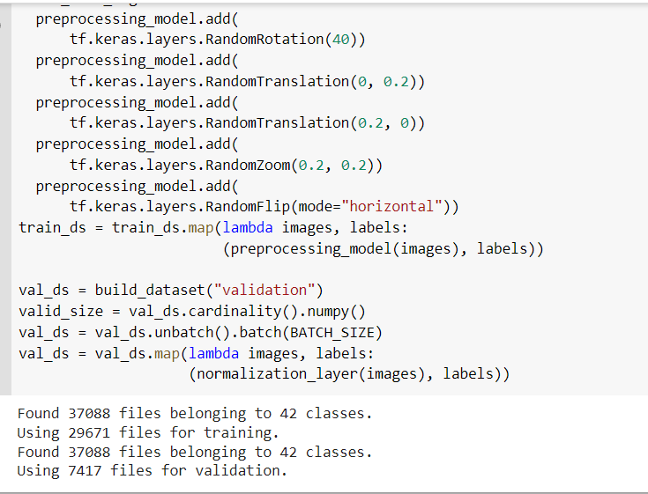
Expected Deliverables
Data Input: The model like any other Transfer Learning model takes input of the image converted into any image of fixed size like 224*224 for Efficient Net, Mobile Net etc. The Data being used undergoes some Augmentation like Rotation of images by some degree, zoom in ,zoom out. After this the input is sent as a numpy array of RGB values.

Slide 11
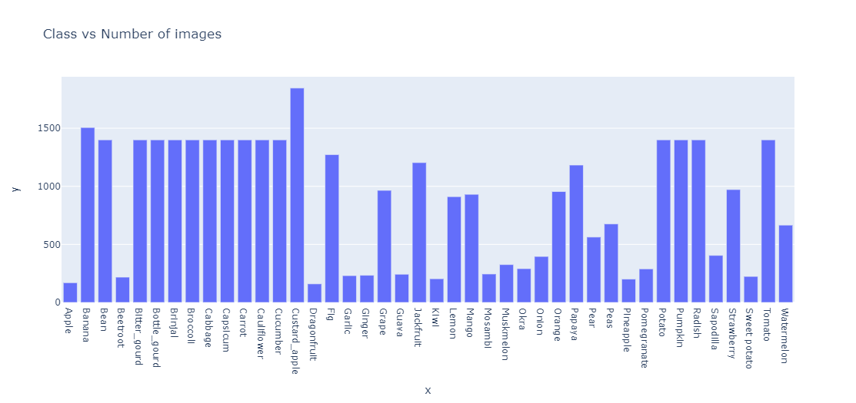
Expected Deliverables
Data Visualization: Images vs Class

Slide 12
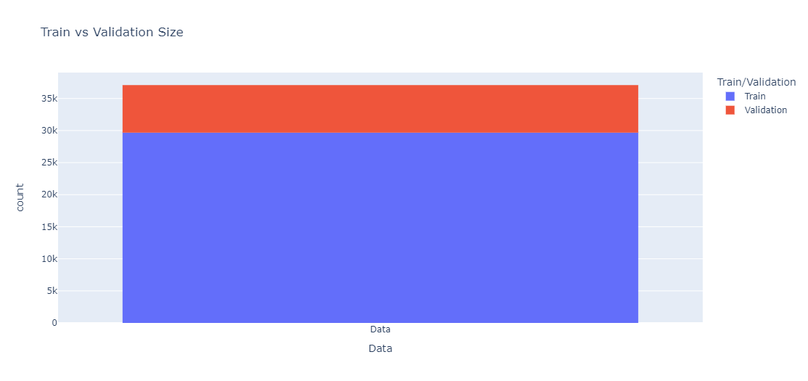
Expected Deliverables
Data Visualization: Images vs Class

Slide 13
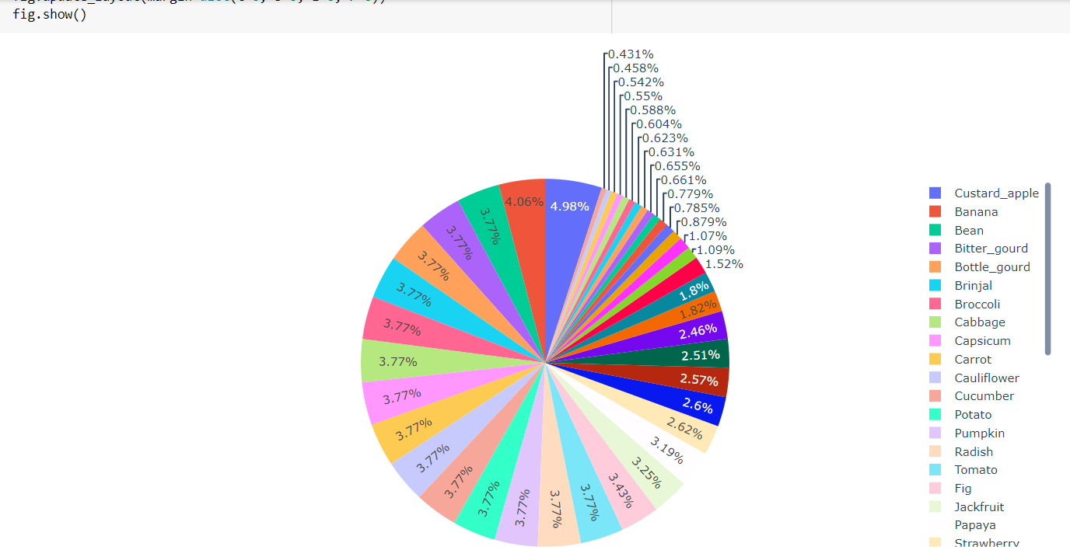
Expected Deliverables
Data Visualization: Percentage of Classes

Slide 14
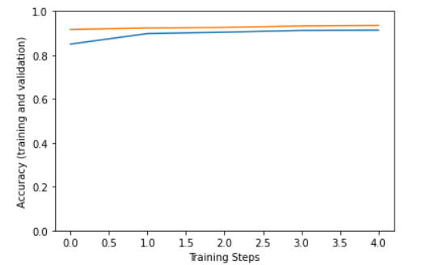
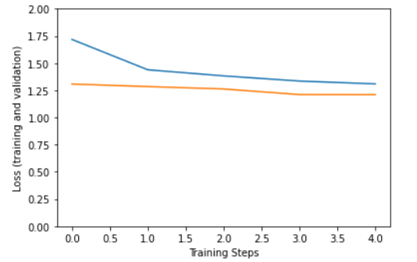
Expected Deliverables
Data Visualization: Efficient Net V2
Training and Validation Accuracy
Training and Validation Loss

Slide 15
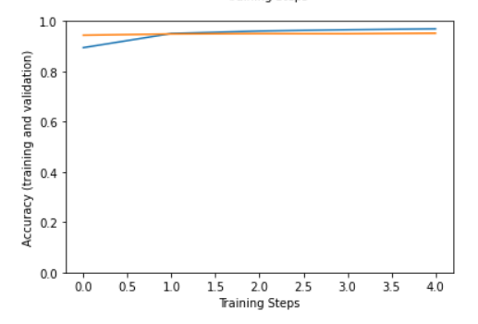
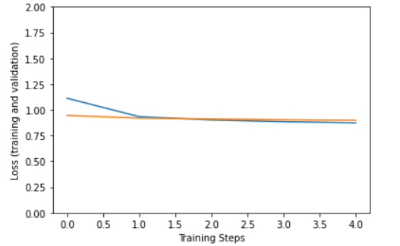
Expected Deliverables
Data Visualization: Mobile Net V2
Training and Validation Accuracy
Training and Validation Loss

Slide 16
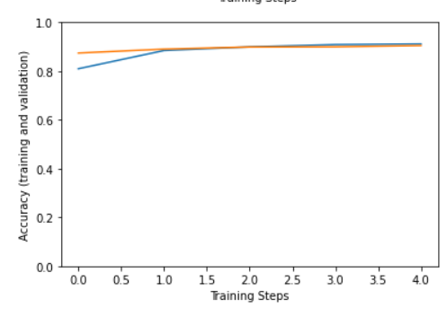
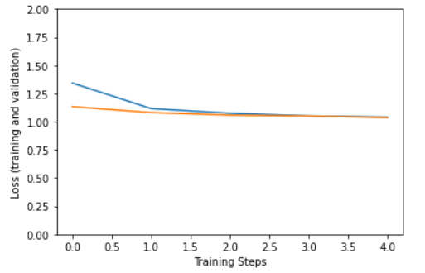
Expected Deliverables
Data Visualization: NasNet_Mobile
Training and Validation Accuracy
Training and Validation Loss

Slide 17
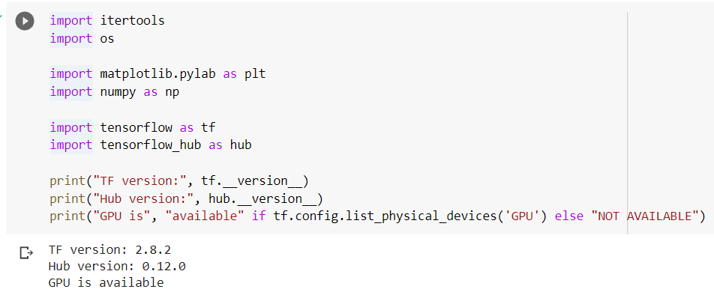
Expected Deliverables
Data Interpretation: Data is stored in the relevant file system structure enabling the classes to be easily distinguished. As Such One major conclusion which can be drawn when working on data related to multi class classification is that the quality of images in dataset play a major role in determining the accuracy of the final model developed.
Storage : Currently The Entire Dataset is stored on Google Drive as a zip file as it allows easy extraction and working with Google Colab which is being used currently to train our models at a higher speed for higher number of epochs on GPU.

Slide 18
Expected Deliverables
Individual contribution of the team members
SRN | NAME | Task Assigned | LOC | Time Spent
PES2UG19CS198 | Kuntal Gorai | Build the Necessary Models, Dataset Collection, Dataset Structure Finalization.
PES2UG19CS346 | SVSC Santosh | Integrate Models with app, Dataset Collection, Dataset Structure Finalization.
PES2UG19CS391 | Skanda S | UI Design, Dataset Collection, Explore Transfer Learning with VGG 16.
PES2UG19CS454 | Vijay Murugan AS | UI Design, Dataset Collection, Explore Transfer Learning with VGG 16.

Slide 19
Expected Deliverables
List the SDK / API / Model / Jar/ DLL / Tools / Technologies used – Open-Source/ Licensed.
Testing for the module that is completed.

Slide 20
Expected Deliverables
Demonstration and Result of modules completed.
Tabulate the timeline for all the tasks/modules.

Slide 21
References
Provide references pertaining to your research according to IEEE format.
Example:
G. Eason, B. Noble, and I. N. Sneddon, “On certain integrals of Lipschitz-Hankel type involving products of Bessel functions,” Phil. Trans. Roy. Soc. London, vol. A247, pp. 529–551, April 1955. (references)

Slide 22
Thank You

